Slide 1
WELCOME
Notes:
Please have this screen up as people enter the room. No conversation from you as of yet.

Slide 2
Notes:
Play this video, with NO introduction or comments.
Start it as everyone is seated and they will quiet down.
Make sure the volume is all the way up.

Slide 3
Chen Miller is an Extraordinary Teacher
“Kids do hear and feel what we say.”
“They tell us who makes them feel badly and who makes them feel good.”
What are your take aways?
How do you want your students to think of you?
Notes:
Ask each participant to use the index cards provided to respond to these two questions.
Have them keep their cards. (self-refection activity)

Slide 4
Equity Literacy: Manchester School District
Presented by a collaboration between the Manchester Education Association and the Manchester School District
Notes:
Welcome to this training. The Manchester Education Association sent a small team to Baltimore last year to learn about Equity Literacy. What they discovered is that we all need to have conscious thought and planning for ALL of our students, with a particular understanding of the barriers and roadblock that so many of our students in Manchester are experiencing. We know that many of our students have daily struggles and experience daily layers of injustice- economic, social class, poverty, homelessness, food insecurity, race, culture, learning styles, academic gaps, mental health concerns, sexual orientation and identity, and school quality.
How we understand and approach these barriers and roadblocks is what we will be learning about today. Confidentiality needs to be respected today. No video or audio taping is allowed, cell phones put on silent please. Step out if you need to take or make a call.
SHOW BRIEF VIDEO BY THE GRANITE STATE YOUTH ORGANIZING PROJECT.

Slide 5
Notes:
3-MINUTE VIDEO BY THE GRANITE STATE YOUTH ORGANIZING PROJECT.
NO CONVERSATION AFTER SHOWING IT…JUST MOVE TO THE NEXT SLIDE.

Slide 6
Elements of Equity Literacy
How to create a safe and caring learning environment for all learners that values relationship in both word and deed
Equity Literacy is the ability to recognize bias and inequities and the willingness to disrupt those patterns
Notes:
A framework for both multicultural curriculum development and bigger efforts to create equitable classrooms and schools. This framework is EQUITY LIETERACY.
This relies more on educators’ understandings of equity and inequity and of justice and injustice than an understanding of any specific culture.
It relies, as well, on educators’ abilities to cultivate in students a robust understanding about how people are treated by another and by institutions, in addition to a general appreciation of diversity.
The idea is to place EQUITY, rather than culture, at the center of the diversity conversation.

Slide 7
Desired Understanding
An understanding of what is equity literacy and where are we in the process of developing it
Recognizing the barriers that students face in Manchester to access opportunities and learning
A willingness to “lean into” uncomfortable spaces within ourselves, colleagues, and community to develop equity literacy
Notes:
What is Equity Literacy? Where is the Manchester School District in the process of providing equity to ALL of our students?
The Office of Civil Rights (OCR) findings 5-years ago, point out that we have a lot of work to do, especially in professional development for all of our staff. Today is not a 1-time event. There will be occasions for each of us to continue our growth throughout the year through on-line and face-to-face learning opportunities.
What is “leaning into” uncomfortable spaces? It is our willingness to self-reflect on how we perceive race, sexual orientation, gender, special education, mental health concerns, poverty and other life issues that are real for our students.
It is also our ability to be honest with ourselves: “not seeing color” when we work with students is not helpful or a true strategy that will assist our students in moving through obstacles to their access to learning opportunities.
Seeing others for who we truly are is the goal, understanding what each of our students need to achieve at their highest potential is the goal.

Slide 8
Desired Understanding
An agreement to develop strategies to assist students without hindering them
Understanding of our mindset about working with students that are different from us
What it means to be a culturally responsive practitioner
Notes:
Learn and perceive differently, self-reflection
Hopefully we will all leave today with a desire to learn more, view the barriers and roadblocks for our students as opportunities for us to refresh our practices as well as to find ways to lift up each of our students.
While being an educator today is a much more difficult job than ever before, life circumstances for your students is even more difficult. The increase in poverty, Manchester being a refugee center, increasing numbers of students with severe or layered learning needs, the impact of the opioid crisis, homelessness, mental health concerns, the increase of aggression and violence, and so many other factors are overwhelming our students and their families. How do we help each student in a mindful approach so that we are expecting each student to reach up to the expectations while increasing our understanding and support to make our schools more equitable?
Does this mean we lower expectations? Allow students and families to make excuses about difficulties? Or do we frame EVERYTHING we do with understanding through increased knowledge?
Culturally Responsive Practitioner-culturally sensitive is an awareness of different cultures, we are moving towards responsiveness which is deeper than awareness.

Slide 9
Cultivation of Skills and Consciousness
Recognize
Respond
Redress
Create & Sustain
Notes:
Equity Literacy is the cultivation of skills and consciousness that enable us to address conditions that deny some students access to educational and other opportunities enjoyed by their peers.
Recognize: Recognize biases and inequities, including subtle ones in materials, classroom interactions and school policies.
Respond to Biases and Inequities, in the immediate term: Intervene when they arise in classrooms or school grounds, foster conversations with colleagues about equity concerns at your school.
Redress biases and inequities in the long term: Advocate against inequitable school practices, such as racially or economically biased tracking, advocate for equitable school practices. Parents identify “race’ for school records, how accurate is it based on the limited “categories” that the U.S.
Create and sustain bias-free learning environments: Express high expectations for ALL students through higher-order curricula and pedagogies, consider how you assign homework and communicate with families. Who are the parental units? How do they view equity in education and life?

Slide 10
Courageous Conversations
Stay engaged
Speak your truth
Experience discomfort
Expect and accept non-disclosure
Notes:
Do not let your heart and head check out of the conversation! We all need to make a personal commitment, regardless of the engagement of others. Remain morally, emotionally, intellectually, and socially involved in the dialogue. Please turn your phone to silent or vibrate. If you need to take a call, please step out to do so.
To speak your truth, you must be willing to take risks and be absolutely honest about your thoughts, feelings and opinions. And not just say what you think others want to hear. Disagreement is normal and OK It is part of the learning process to think about why you disagree with something and then respond to the idea vs. the person.
For example, to deal with the reality of race in an honest and forthwith way, we ask you to agree to experience the discomfort which is expected due to the problematic state of racial conditions in our society.
This workshop will not solve long-standing racial issues that we have in our country. There is no quick fix or solution to the challenges we face. On-going self-reflection, dialogue, and action is required and essential.
* We make a lot of assumptions about students and their families. How can we best go beyond the assumptions?

Slide 11
Courageous Conversations
Confidentiality
Notice patterns of participation
24-48 hour rule
No hearsay rule
Notes:
To support each other in our risk-taking, we agree to respect the privacy of everyone’s identity and life experiences, but reserve the right to share ideas and content publicly.
To support each other and the process, we agree to participate fully. Everyone’s voice is important and a valuable contribution to our conversations. We also agree to converse “across difference’ to build our understanding and awareness of others’ backgrounds and experiences.
To make sure that we are being honest with ourselves and each other, we need to practice sharing things that bother us directly with that other person (not with others). We agree to speak directly to one another, and if we have not done so within 24-48 hours following out feelings, we agree to make peace with the situation and let it go.
We agree to go to the source for any information that confuses or upsets us. We do not gossip or spread rumors. No hearsay, real stories can create a much more long-lasting impact on change.

Slide 12
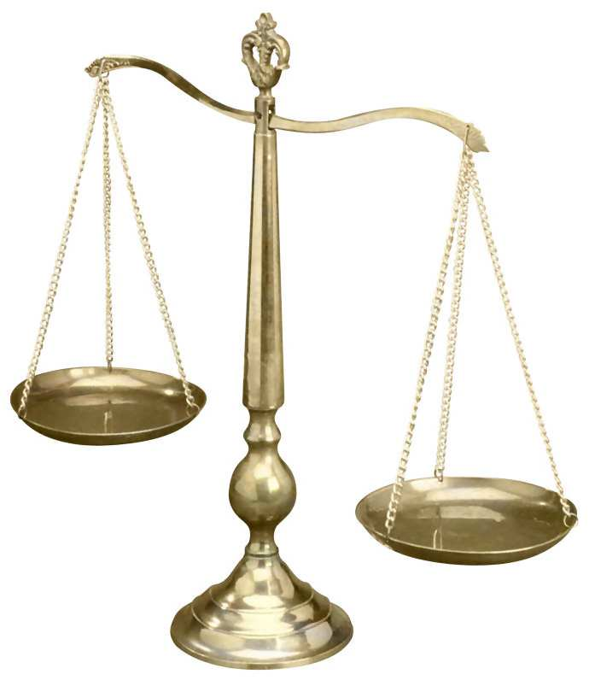
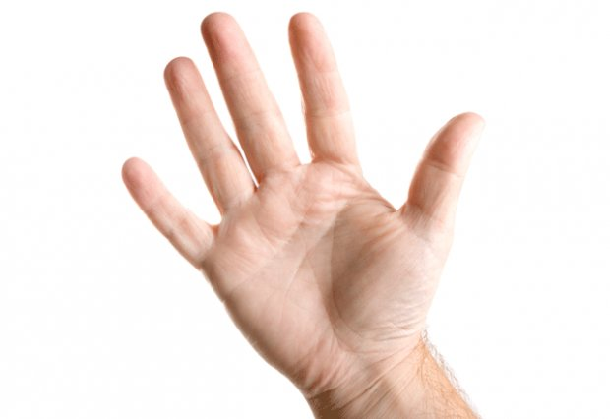
Courageous Conversations Compass
Moral: A strong sense of right and wrong.
Intellectual: A need to know more information about the issue.
Emotional: Strong emotional connection to the issue.
Social: Wanting to do something to address the issue.
Notes:
A navigation tool for understanding multiple perspectives
.
How do people react during conversations?
How do you react during conversations?
Emotional: Parents and family members being deported
Social: Marches, protests, letter writing, testimony, “social justice warriors”
Suggestion: You can use this exercise in a classroom setting- read a headline from today’s paper, ask students to think about their response- and move to the corner of the room which you think best represents your response. Each corner group shares and then reports out to the entire class.
When teaching students how to form work groups, share the importance of having a variety of people with different conversational reactions to best balance the work.

Slide 13
What We Know
We know that many students have daily struggles in the MSD and on issues of injustice are pervasive for them
Economic, social class, race, and school quality are significant concerns
The first step in addressing inequities involves critical self-reflection
Authentic collaboration is needed to disrupt inequity patterns
Notes:
ACTIVITY: Turn to a person near you and briefly discuss (3 minutes), and make a list (use index cards), of what you think the specific barriers are for some of your students. what have you observed, or heard, over the recent years as specific examples.
Come back together after the 3 minutes, ask for some staff to share their conversations. (5 minutes)

Slide 14
Five Guiding Principles
Equity literacy is important in every subject area
The most effective approach is integrative and interdisciplinary
Students of all ages are primed for equity literacy
Students from all backgrounds need equity literacy
Teaching for equity literacy is a political act- but not more so than not teaching for equity literacy
Notes:
Curricular will look different because of the difference in contextual factors.
Instead of a list of facts or historical figures, an equity curriculum focuses on essential questions like;
- What makes something equitable or inequitable?
What (local, region, global) inequities exist?
How have they changed over time, and why?
What individual and collective responsibilities do we have to address them?
These questions require both evidence and ethics to debate.
Five Guiding Principles:
We do not abandon content; rather we are teaching content through an equity lens.
The process is just as important, if not more important, than the actual outcome of their efforts.
Even pre-school students have been exposed to socializing messages about themselves and one another.
Traditional forms of multicultural education that focus on celebrating diversity rather than equity can reinforce misunderstanding by feeding the assumption that celebrating diversity is enough.
5. How can we prepare young people to be active participants in a democracy without teaching them about the most formidable barriers to an authentic democracy?

Slide 15
Definitions: Equity vs. Equality
Equity: Fairness; “learning that improves the learning of all students; prepares educators to understand and appreciate all students; creates safe, orderly, and supportive learning environments; and holds high expectations for their academic achievement.”
Equality: One possible outcome of an equitable system
Notes:
A framework for both multicultural curriculum development and bigger efforts to create equitable classrooms and schools. This framework is Equity Literacy.
This relies more on educators’ understandings of equity and inequity, and of justice and injustice, than an understanding of any specific culture or roadblock.
It relies, as well, on educator’s abilities to cultivate in students a robust understanding about how people are treated by another and by institutions, in addition to a general appreciation of diversity.
The idea to place EQUITY, rather than culture, at the center of the diversity conversation.
Equal is that all are offered something
Fair is when the needs of each individual is addressed

Slide 16
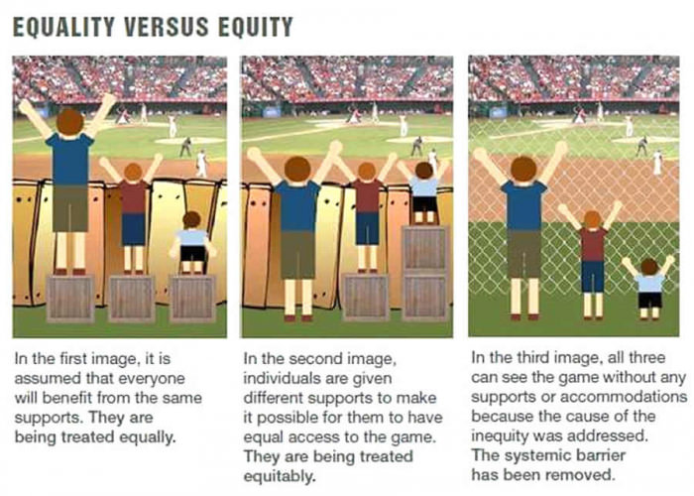
Notes:
Read each slide information out loud. We used to only see the first 2 slides, the 3^{rd is} the goal of equity literacy.

Slide 17
Deficit Thinking
Stop and Frisk
Overweight people are lazy
Students with ADHD will not be successful
Distrust of a female mechanic
All male hairdressers are gay
All black kids can play basketball; white men can’t jump
Notes:
How do you really react to and think about these types of students and/or behaviors?
Deficit thinking smacks of a variety of "-isms" -- none of which are at all morally or ethically acceptable in a multi-cultural, global environment. Child A may have a different set of skills and experiences than Child B; but that in no way means Child A's skills and experiences are inferior to Child B's. Our children's futures aren't predetermined. No one is "destined for failure" -- at least not until we convince them they are through our good efforts to help them overcome their deficits and "save them" from their lives.
Stop and Frisk is racial profiling- what else is similar?
How do we reframe our thinking to positive thinking about children and their families?
What other types of deficit thinking or comments are you aware of? Ask the participants to put some thoughts on an index card. Ask for a few of the participants to share with the larger group.

Slide 18
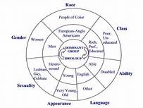
Intersectional Approaches to Race and Gender
Circle of Oppression
Notes:
ACTIVITY : Have each person shade or color their wheel as to what is specific to them. They can shade a part or a the whole of any part of the circle as it applies to the person they are right now.
Then, have them share with the person near them. Similarities? Differences?
The dominant group is the group that make laws, rules and decisions about how everyone else is going to act and behave.
The further you are from the dominant group, the more you may face daily oppression. (voter suppression, educational opportunities, etc.).

Slide 19
Learning through Culture and Difference
White= Caucasian Red= Native American
Black= Black Purple= Other
Brown=Hispanic Light Green= Non-Gender
Silver=European Orange= Asian Pacific/Islander
Light Pink=LGBT Yellow= Middle Eastern
Dark Pink or Gold=Female Dark Green or Any Blue= Male
Notes:
ACTIVITY: BEADS:
Share what each color represents, each person takes a bead representing their response to your questions (ask the following questions) and puts them in their cup.
When all done, ask the participants to put their beads back in the plastic bag and close it.
When all of the questions have been asked, have people get into groups pf 4-5 and share their differences and similarities.
If we do not have contact with people who are different from us, does it impact our ability to be successful with all of our students?
Questions to ask:
Please put the bead/beads into your cup that best represents:
You
If you have one, your partner, spouse or significant other
Your children and/or grandchildren
The people that live on your street or in your building
Your work colleagues (team, dept, grade level, office)
Your primary physician? Your dentist? Other regular health care providers, including mental health professionals
Who visits your home on a regular basis (your friends, your children’s friends)
If you or any close family/friends are LGBT
If you or any close family members ever had an IEP or 504 Plan
If you or any close family member has a mental health concern
If you as a child, or now, would be considered to be free/reduced lunch status

Slide 20
How Will We Make the Changes We Want?
How do you take this learning forward?
Can you identify bias and inequity when you see and hear it?
What are you going to do to disrupt inequity and bias?
How will you engage students in learning about these topics? (social-emotional learning)
How do you stay engaged in the learning process?
Notes:
Just let this slide stay up as you thank everyone for their participation.
Some EQUITY AUDIT questions will be sent to you online. Please complete and then you will be given a professional development certificate.

